Slide 1

Propositional logic
Frank van Harmelen
Vrije Universiteit Amsterdam

Slide 2
The goal of logic
The goal of logic in a knowledge base is
To state statements which are know to be true (the “knowledge base”)
To state statements for which we want to check if they are true (the “conclusions”)
To see if the conclusions can be derived from the knowledge base through logical reasoning

Slide 3
The knowledge base: simple statements
We will study knowledge bases that consists of statements in a very simple logic: propositional logic
In propositional logic, a knowledge base can have simple statements, and complex statements.
A simple statement states one fact about the world:
Examples: it-is-hot, it-is-raining, it-is-humid
In our examples we sometimes just use a single letter for a a simple statement:
Examples: P, Q, R.

Slide 4
The knowledge base: complex statements
Complex statements are made by combining other statements. If S and T are statements (simple or complex), then the following are also complex statements:
S ∧ T (“S and T”) (conjunction)
S ∨ T (“S or T”) (disjunction)
¬ S (“not S”) (negation)
S → T (“S implies T”) (implication)
These can be combined any combination
Examples:
it-is-hot ∧ it-is-raining
¬ it-is-humid
it-is-hot ∧ it-is-raining → it-is-humid
(P1 ∨ ¬ P2) ∧ P3)
((P ∨ H) ∧ ¬ H) → P

Slide 5
The meaning of simple statements
So now we know the language of propositional logic (the simple statements and the complex statements)
What is the meaning of statements in logic?
In logic, any statement is either true or false.
We call this the “interpretation function” I: it maps any statement p to true or false: I(p)=0 or I(p)=1 (0 means false, 1 means true)
Example:
I(it-is-hot)=1 means that it is hot today
I(it-is-hot)=0 means that it is not hot today
I(Q)=1 means that Q is true

Slide 6
The meaning of complex statements
As we have seen, complex statements are made from combining different parts (using ¬, ∨, ∧, →)
Therefore, the meaning of complex statements is calculated from the meaning of the parts:
The meaning of P∧Q is calculated by combining the meaning of P and Q:
P∧Q is only true if both P and Q are true, otherwise P∧Q is false.
Mathematically: I(P∧Q)=1 only if I(P)=1 and I(Q)=1
We can also write this in a table, which tells us the meaning of P∧Q for each combination of P and Q:
P | Q | P∧Q
1 | 1 | 1
1 | 0 | 0
0 | 1 | 0
0 | 0 | 0

Slide 7
The meaning of complex statements
In the same way, the meaning of P ∨ Q is calculated by combining the meaning of P and Q:
P ∨ Q is only true if at least one of P and Q are true, otherwise P ∨ Q is false.
Mathematically: I(P ∨ Q)=1 only if I(P)=1 or I(Q)=1, or both
We can also write this in a table, which tells us the meaning of P ∨ Q for each combination of P and Q:
P | Q | P∨Q
1 | 1 | 1
1 | 0 | 1
0 | 1 | 1
0 | 0 | 0

Slide 8
The meaning of complex statements
In the same way, the meaning of ¬ P is calculated from the meaning of P
¬ P is only true if P is false, otherwise ¬ P is false.
Mathematically: I(¬ P)=1 only if I(P)=0
We can also write this in a table, which tells us the meaning of ¬ P for each meaning of P:
P | ¬ P
1 | 0
0 | 1

Slide 9
The meaning of complex statements
The meaning of P → Q also computed from the meanings of P and Q, but in a bit of a strange way:
You know by now that by “the meaning of a statement” we think of the “truth” of a statement
The meaning (truth) of simple statements such as P is given by an interpretation function I(P)
The meaning (truth) of complex statements is computed from the meaning of its parts using the truth-tables.
P | Q | P→Q
1 | 1 | 1
1 | 0 | 0
0 | 1 | 1
0 | 0 | 1

Slide 10
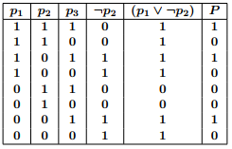
The meaning of complex statements
We can use these tables to determine the meaning (the “truth”) of very complex statements:
To calculate the meaning of (P1 ∨ ¬P2) ∧ P3
we do the following (read the table left-to-right):
take all 8 combinations of the possible values for P1, P2 and P3
Calculate the value for ¬P2 from the values of P2
Calculate the value for (P1 ∨ ¬P2) by combining the values for P1 and ¬P2
Calculate the value for (P1 ∨ ¬P2) ∧ P3 by combining the values for (P1 ∨ ¬P2) and P3

Slide 11
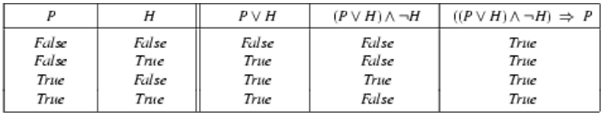
Special statements: tautologies
Let’s look at the complex statement ((P ∨ H) ∧ ¬ H) → P.
If we use the truth table method to determine the meaning (truth) of this statement, we get:
There is something special with the result in the final column: this statement is always true!
In other words: in any combination of P and H, in any world that we can possibly imagine, this complex statement is alwas true.
Such statements, wich are true in any world that we can possibly imagine, are called tautologies (or: valid)

Slide 12
Special statements: inconsistencies
There are also statements which are always false. They are false for any of the possible combinations of truth-values of their parts, in other words, they are false in every world we can possibly imagine. Such statements are called inconsistent (or: invalid).
The statements which are not a tautology and also not inconsistent (in other words: they are true for some combination of truth values and false for others) are called satisfiable
Example: (A ∨ B) ∧ (¬A ∨ ¬B) is satisfiable,
but not a tautology.

Slide 13
Satisfiability testing
Questions to a knowledge base can be solved by
1. Formulating the question as a complex statement, and
2. Testing under which conditions that complex statement is satisfiable.
In other words:
Questions to a knowledge base can be solved by testing if a complex statement is true for some combination of truth values of the simple statements.
In other words:
For a complex statement made up of parts P1, P2, P3, etc we must find truth values for P1, P2, P3, etc (for example P1=0, P2=1, P3=1, etc) in such a way that the complex statement becomes true.

Slide 14
So why are we doing all this?
We now have language in which we can make simple and complex statements about the world ( “propositional logic”)
We can formulate problems that we need to solve as complex statements in propositional logic
We have a truth-table method to determine if a statement can be made true (“satisfied”) by combining the truth values of the simple parts that make up the complex statement
Such a “satisfying truth assignment” is then the solution to our problem.

Slide 15
Satisfiability testing
We want to answer a question
We formulate question as a complex statement
We try to find a “satisfying assignment” of truth values (in other words: a combination of truth values that makes the complex statement true
That combination of truth values gives us the solution to the original problem.

Slide 16
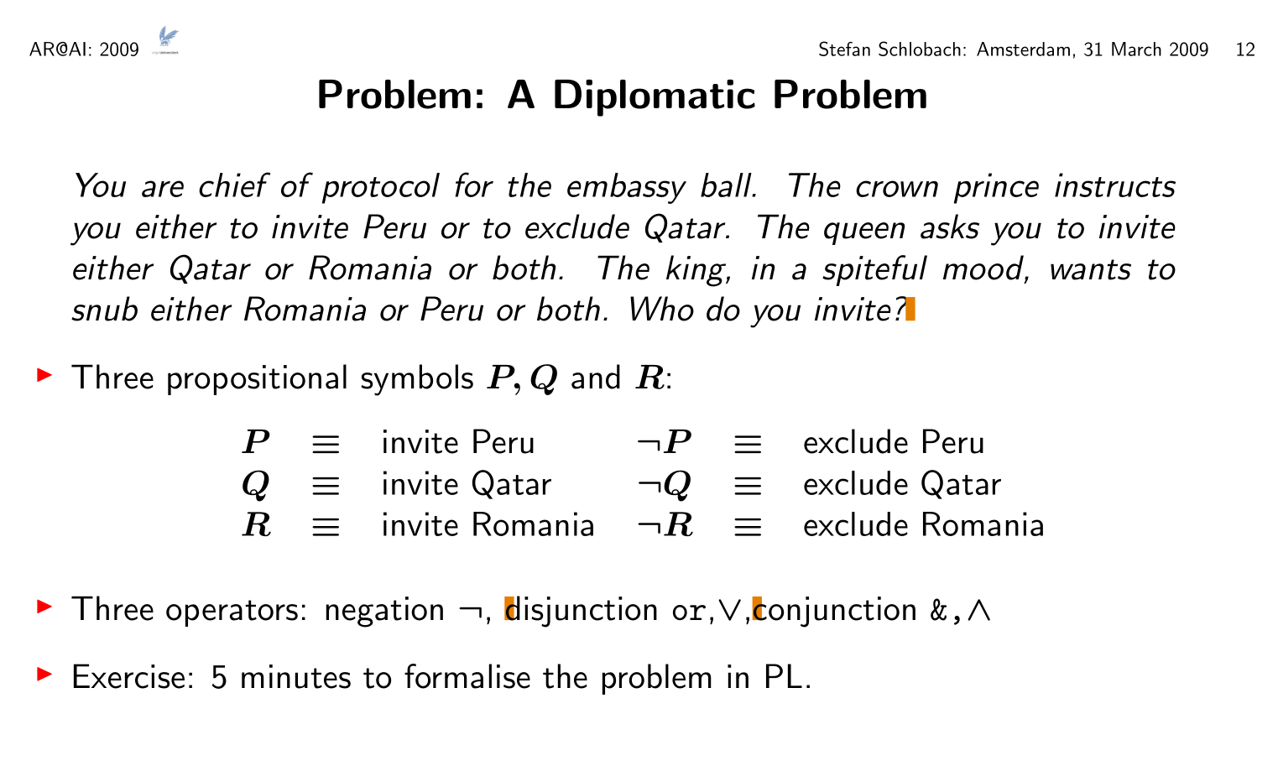
“snub” = not invite

Slide 17
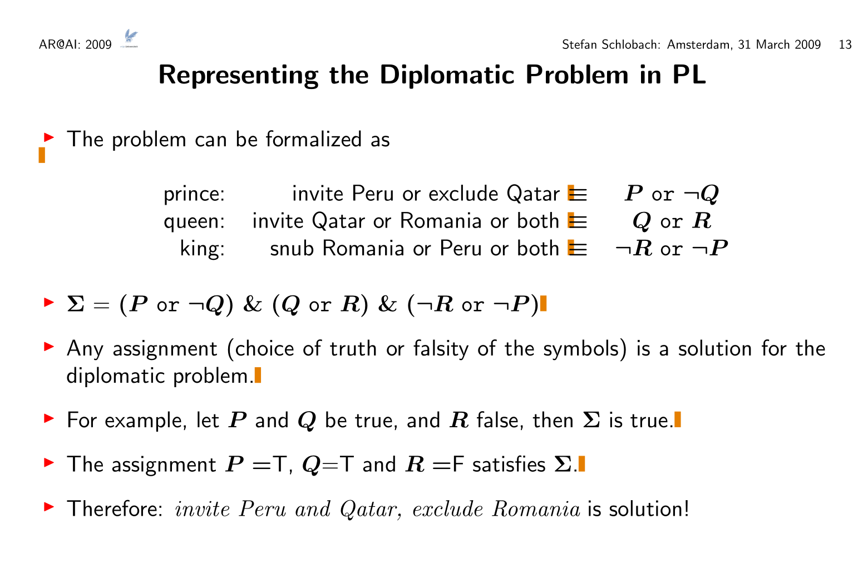

Slide 18
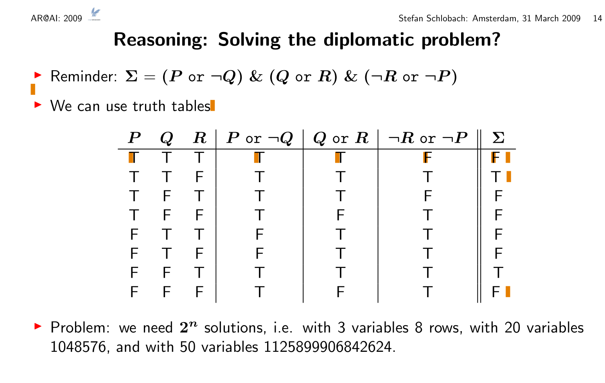

Slide 19
A special form of statement: the clausal normal form
Of course complex statements can be very complex, with many combinations of ¬, ∨, ∧, →
But fortunately, there is special kind of complex statement (the ‘clausal normal form’) with the property that any complex statement can be rewritten as a clausal normal form.
The clausal normal form looks like;
(P₁∨P₂∨… ∨P_{k})∧(Q₁∨Q₂∨… ∨Q_{n}) ∧ …∧ (R₁∨R₂∨… ∨R_{n}) In other words: it is a conjunction of disjunctions.
Note: each of the letters can be positive (P_{k}) or negative (¬P_{k}).

Slide 20
How to rewrite a statement into Clausal Form
❶ Remove implications
(p → q) = (¬p ∨ q)
Move negations in front of propositional symbols
¬(p ∨ q) = ¬p ∧ ¬q
¬(p ∧ q) = ¬p ∨ ¬q
Move conjunctions “outside” over disjunctions
r ∨ (p ∧ q) = (r ∨ p) ∧ (r ∨ q) (result: a conjunction of clauses)
You can read the separate clauses:
(p₁ ∨ p₂ ) ∧ (q₁ ∨ q₂ ) = (p₁ ∨ p₂ ), (q₁ ∨ q₂ )
❺ Sometimes we write a disjunction of clauses as ((p₁, p₂), (q₁, q₂ ))
The outer comma means conjunction (“and”) the inner comma means disjunctoin (“or”)
This can be done for any propositional formula It doesn’t matter in which order you apply the rule, the result is always the same

Slide 21
How to rewrite a statement into Clausal Form
You may also have to use simplification rules:
(p ∨ p) = (p ∧ p) = ¬ ¬ p = p
(p ∨ q) = (q ∨ p), (p ∧ q) = (q ∧ p)
(p ∨ q) ∨ r = p ∨ (q ∨ r), (p ∧ q) ∧ r = p ∧ (q ∧ r)
Repeatedly apply rules to the result:
¬(¬ p ∧ (q ∨ ¬r) = ¬¬ p ∨ ¬(q ∨ ¬r) = p ∨ (¬q ∧ ¬¬r) = p ∨ (¬q ∧ r)
Sometimes multiple rules apply (always same result)
((p ∧ q) ∨ r) ∨ s=
((p ∨ r) ∧ (q ∨ r)) ∨ s=
((p ∨ r ∨ s) ∧ (q ∨ r ∨ s))
((p ∧ q) ∨ r) ∨ s=
((p ∧ q) ∨ (r ∨ s) =
((p ∨ r ∨ s) ∧ (q ∨ r ∨ s))
Notes:
NB: volgorde van regeltoepassing maakt niet uit,
Er komt altijd hetzelfde unieke resultaat uit!

Slide 22
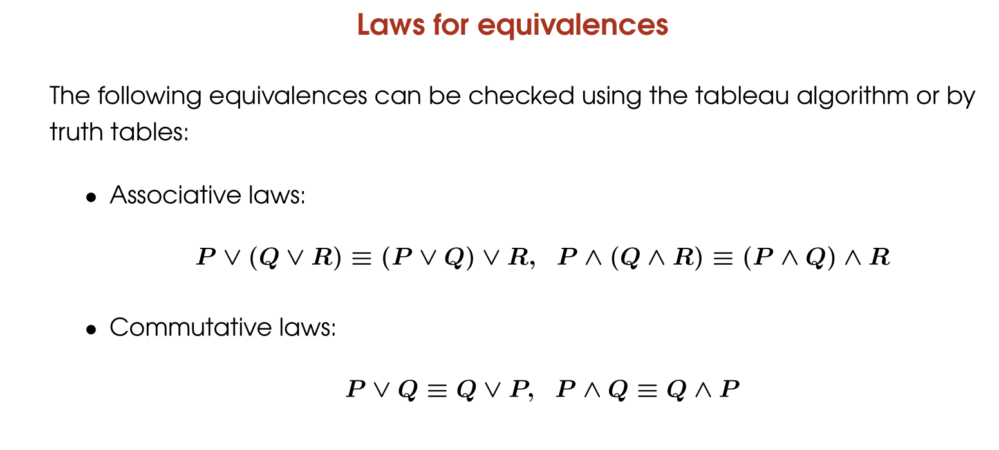
simplification rules

Slide 23
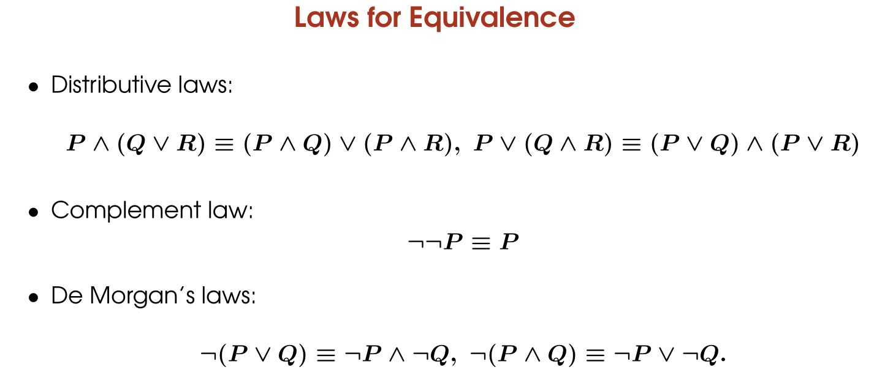
simplification rules

Slide 24
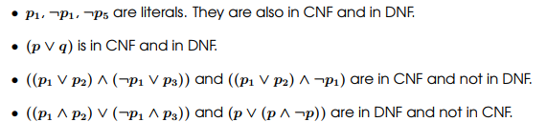
Examples of clausal normal form

Slide 25
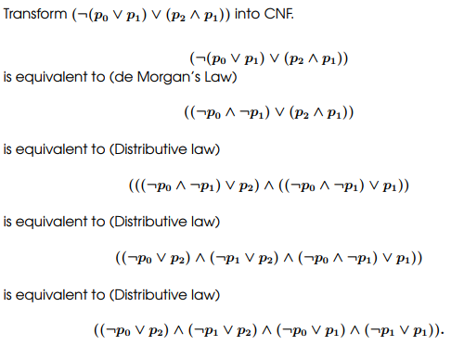
Examples of clausal normal form

Slide 26
Summary: use of propositional logic for problem solving
We want to answer a question
We formulate question as a complex statement
We try to find a “satisfying assignment” of truth values (in other words: a combination of truth values that makes the complex statement true
Rewrite the statement into Clausal Normal Form
Use the truth-table method
Any combination of truth values that is a satisfying assignment gives us the solution to the original problem.

Slide 27
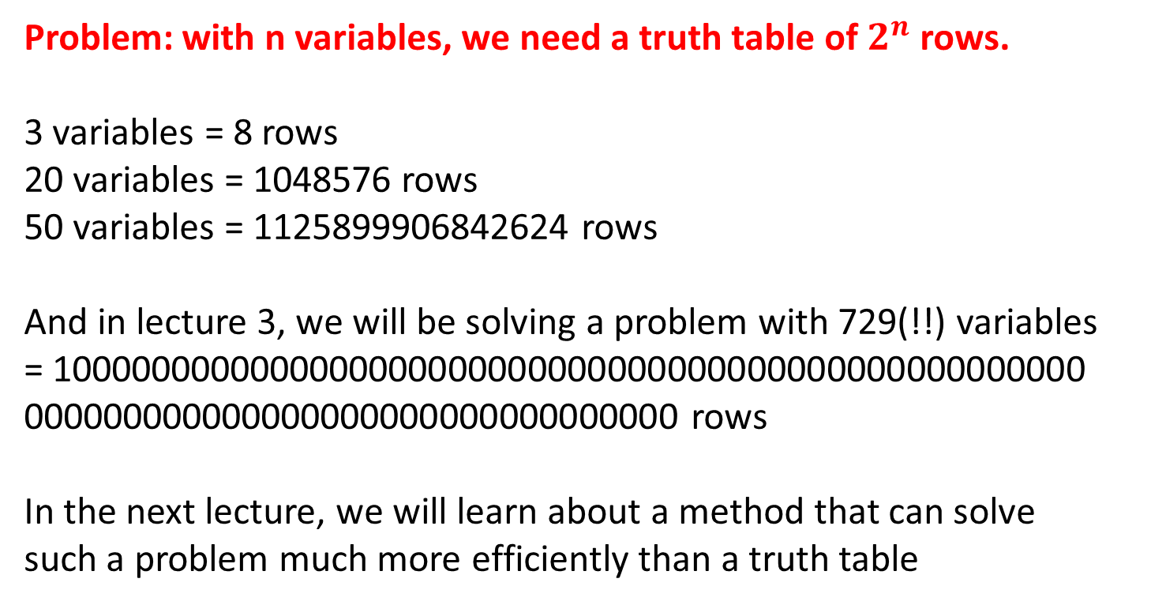
Problem: with n variables, we need a truth table of $2^{n}$ rows.
3 variables = 8 rows
20 variables = 1048576 rows
50 variables = 1125899906842624 rows
And in lecture 3, we will be solving a problem with 729(!!) variables
= 1000000000000000000000000000000000000000000000000000 000000000000000000000000000000000 rows
In the next lecture, we will learn about a method that can solve
such a problem much more efficiently than a truth table

